Slide 1
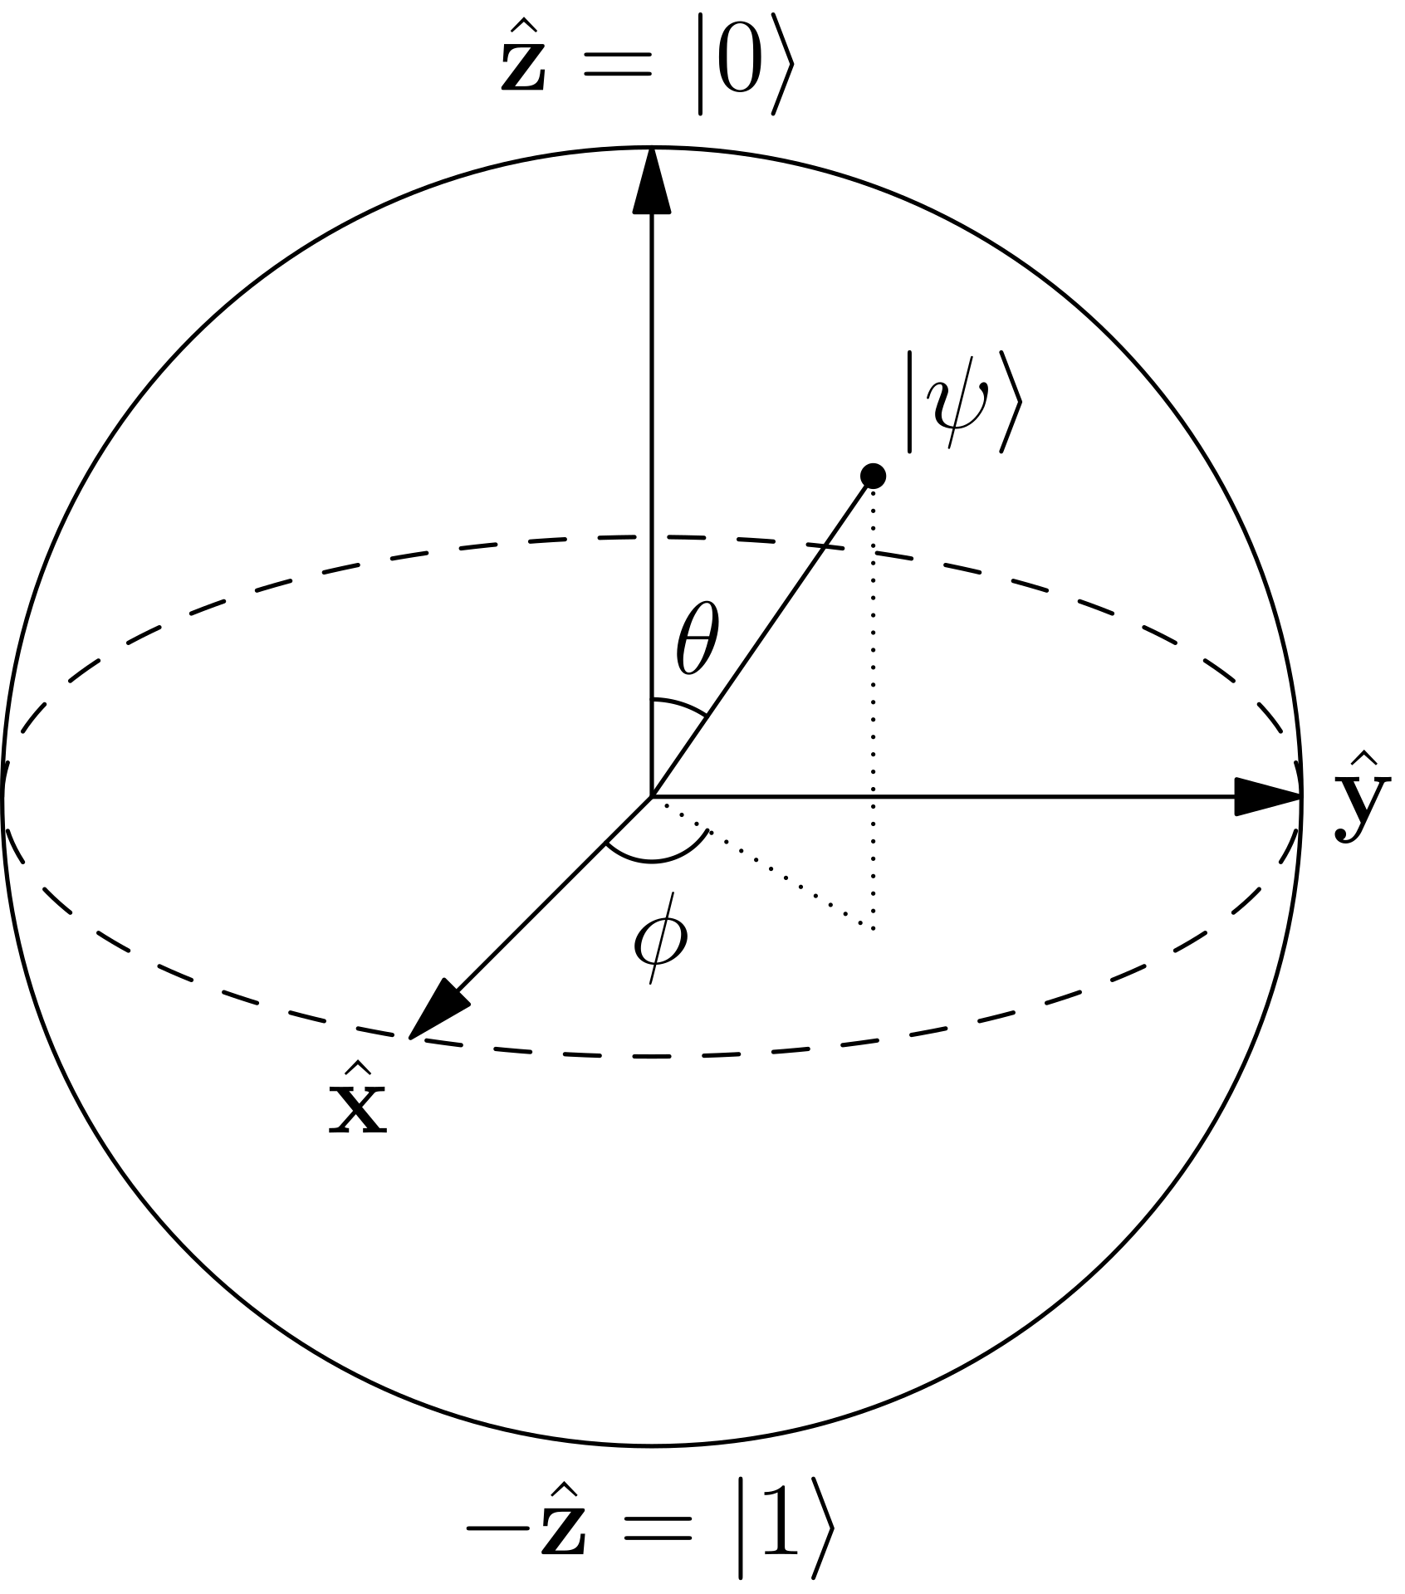
Quantum
Computing

Slide 2
Quantum
Computing
Beginning
The

Slide 3
Computing
Quantum
The
Beginning
The size of the transistor

Slide 4
Beginning
The
The size of the transistor

Slide 5
The size of the transistor
Complexity Theory
$$BPP⊆BQP⊆P^{\#P}$$

Slide 6
The size of the transistor
Complexity Theory
$$BPP⊆BQP⊆P^{\#P}$$
State
Of
The
Art

Slide 7
The size of the transistor
Solve complex problems
P vs NP
Complexity Theory
$$BPP⊆BQP⊆P^{\#P}$$
State
Of
The
Art
DWS
DWS

Slide 8
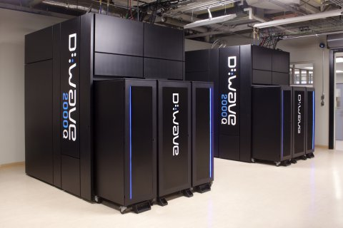
The size of the transistor
Solve complex problems
P vs NP
Complexity Theory
$$BPP⊆BQP⊆P^{\#P}$$
State
Of
The
Art
DWS

Slide 9
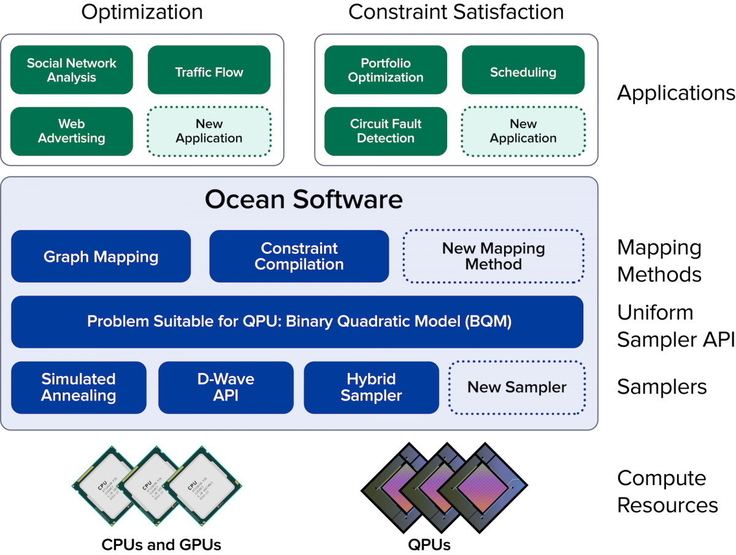
The size of the transistor
Solve complex problems
P vs NP
Complexity Theory
$$BPP⊆BQP⊆P^{\#P}$$
The
State
Of
Art
D-Wave Systems

Slide 10
D-Wave Systems
Energy Efficiency: 25kW

Slide 11

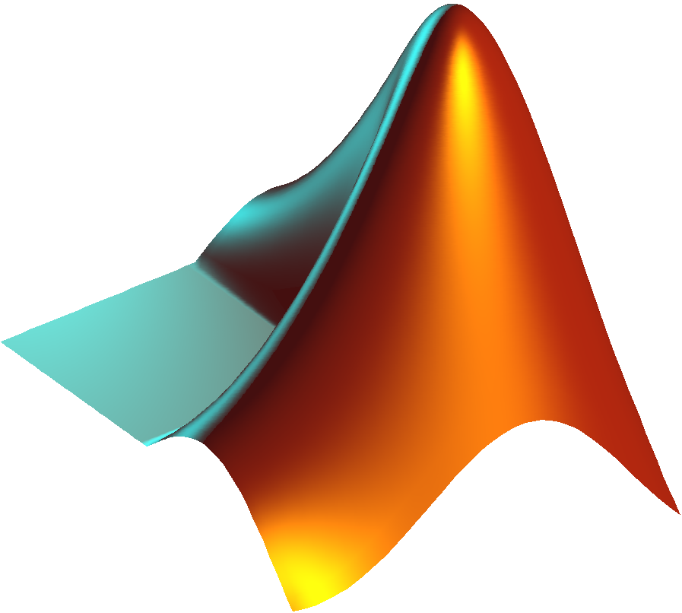

D-Wave Systems
Energy Efficiency: 25kW
Software and WebAPI

Slide 12
D-Wave Systems
Energy Efficiency: 25kW
Software and WebAPI
Real-Life Applications

Slide 13
D-Wave Systems
Energy Efficiency: 25kW
Software and WebAPI
Real-Life Applications
IBM Q Experience

Slide 14

D-Wave Systems
Energy Efficiency: 25kW
Software and WebAPI
Real-Life Applications
IBM Q Experience

Slide 15
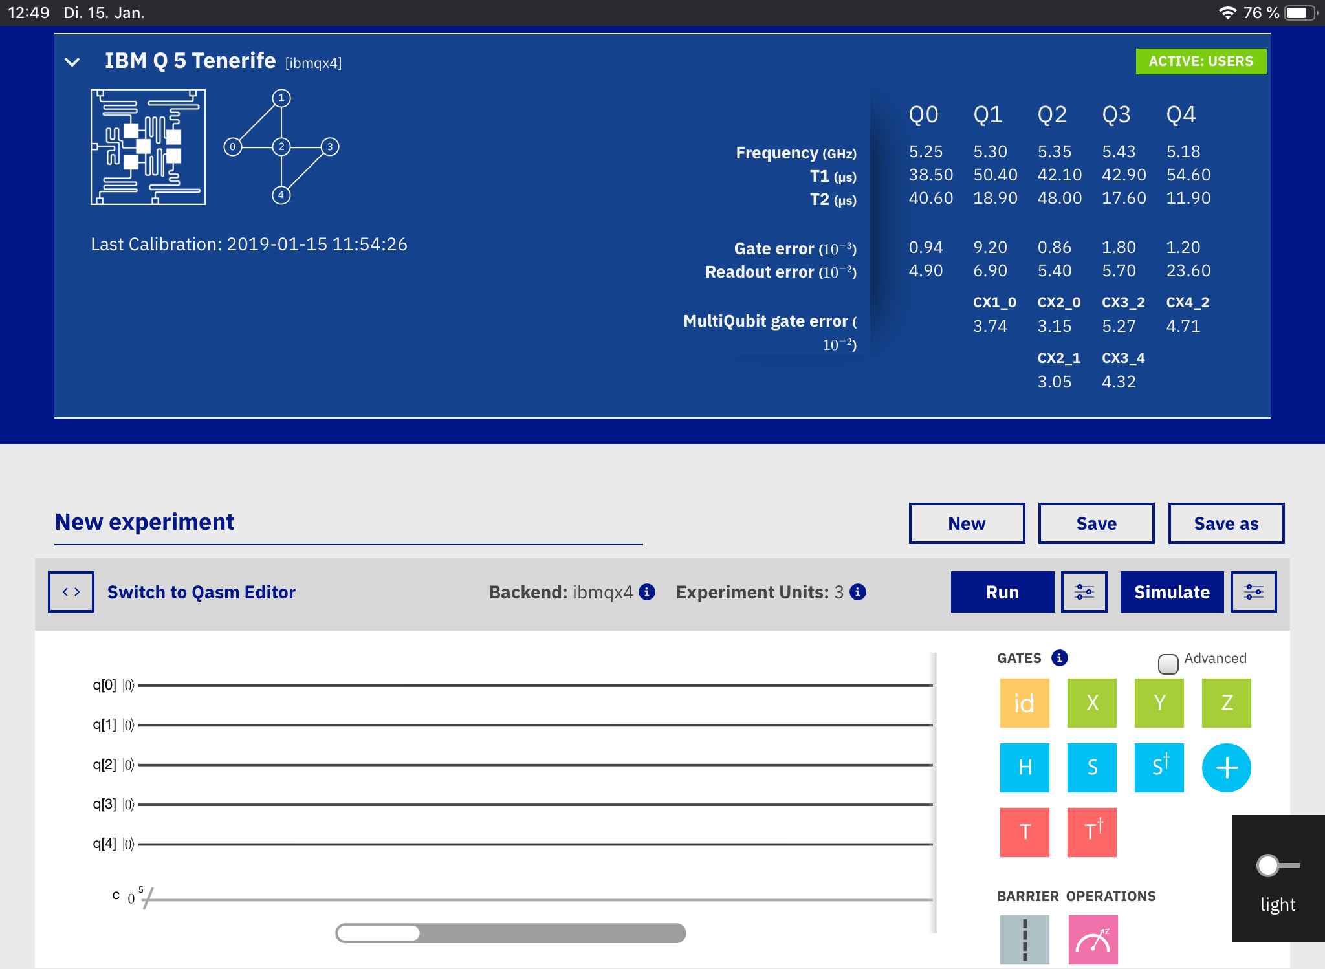
IBM Q Experience

Slide 16
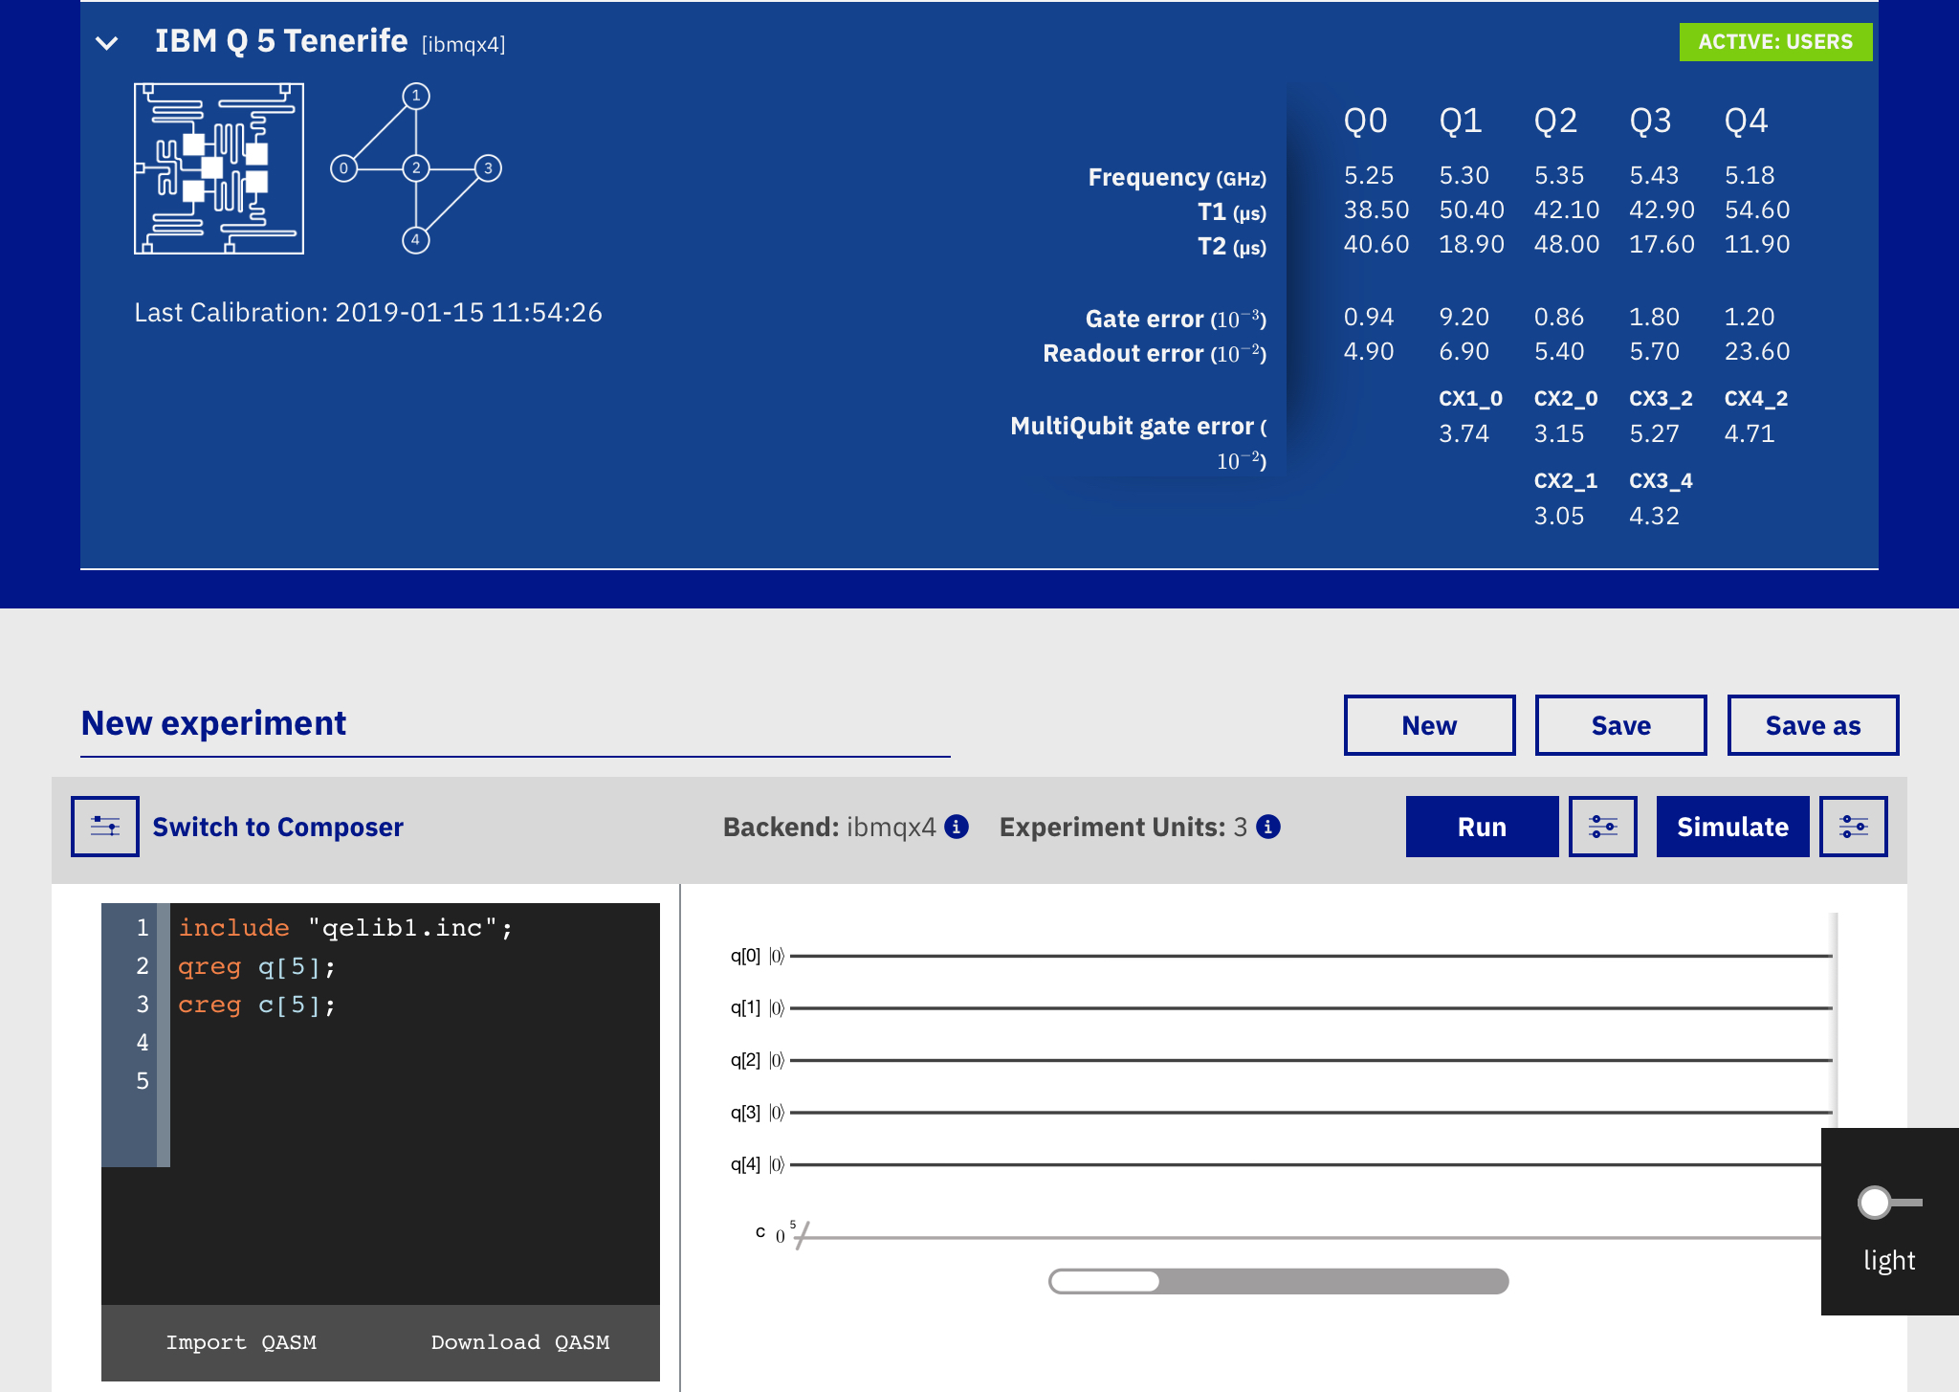
IBM Q Experience
QISKit

Slide 17
IBM Q Experience
QISKit

